Slide 1
HEALTH EQUITY ADVISORY TEAM
Notes:
Slides 2-5 may be omitted based on the allotted time of your presentation.

Slide 2
Agenda
2
Welcome and Introductions
HEAT Overview
HEAT 2023 Guidance Document
Discussion and Questions

Slide 3
Health Equity Advisory Team (HEAT) Overview

Slide 4
Health Equity Advisory Team
4
Overview
The LAN established the HEAT to help identify and prioritize opportunities to advance health equity through APMs, to influence design principles, and to inform LAN priorities and initiatives.
Goal
The HEAT’s goal is to keep the person at the center—leveraging APMs to help make needed care more accessible, drive better patient outcomes, and reduce disparities.
Crucial elements the HEAT explores:
Patient Experiences​
Patient Priorities ​
Patient Perceptions

Slide 5
HEAT Membership
HEAT Membership 2023
Morenike Ayo Vaughn The Commonwealth Fund | Dr. Craig Jones Capitol Health Associates | Kate Davidson CMS | Sinsi Hernández-Cancio National Partnership for Women & Families | Dr. Jorge Petit Services for the Underserved
U. Michael Currie UnitedHealth Group | Jennifer Kons United Way of Greater Cleveland | Chris DeMars Oregon Health Authority | Dr. Jennifer Moore Institute for Medicaid Innovation | Aswita Tan-McGrory Massachusetts General Hospital
Dr. Damon Francis Almeda Health Systems | Dr. Jody Levison Johnson Social Current | Dr. David Nerenz Henry Ford Health System | Dr. Pamela Riley California Department of Health Care Services | Mark Friedberg Blue Cross Blue Shield of Massachusetts
Dr. Romana Hasnain-Wynia Denver Health | Dr. Lenny Lopez University of California San Francisco | Dr. Jose Peña* Rio Grande Valley ACO | Cary Sanders California Pan-Ethnic Health Network | Bukata Hayes Blue Cross Blue Shield of Minnesota
Purva Rawal CMS | Jean Moody-Williams CMS | Jerry Peterson SOGIE Consulting | Christina Severin Community Care Cooperative | Taylor Priestly Covered California
Vanetta Abdellatif Arcora Foundation | Dr. Ellen-Marie Whelan CMS
HEAT Co-Chairs
Dr. Marshall Chin* Richard Parrillo Family Professor of Healthcare Ethics University of Chicago
Bio
Karen Dale Market President AmeriHealth Caritas District of Columbia

Slide 6
HEAT Publications and Accomplishments

Slide 7
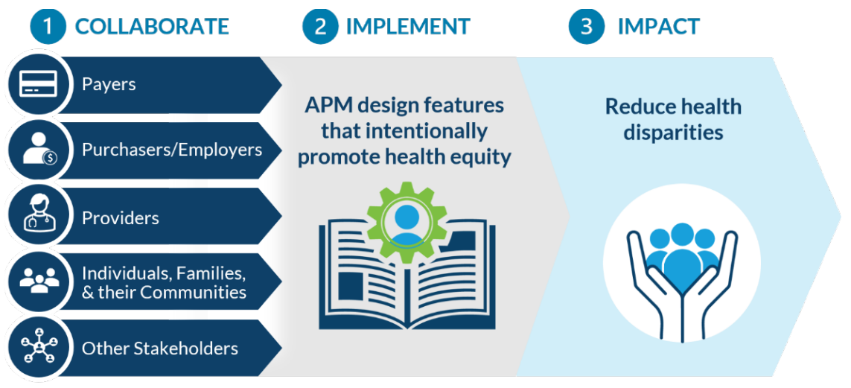
Guidance for Equity-Centered Design and Implementation
7
Advancing Health Equity through APMs, is the HEAT’s foundational guidance document supporting APM stakeholders in designing and implementing equity-centered APMs.
http://hcp-lan.org/workproducts/APM-Guidance/Advancing-Health-Equity-Through-APMs.pdf
Notes:
The HEAT’s foundational guidance document, Advancing Health Equity through APMs, supports APM stakeholders in designing and implementing equity-centered APMs.
Payers and purchasers
can adopt promising design elements into APMs in an aligned manner to maximize provider uptake and the positive impact of APMs on health equity.
Providers
participating in these APMs can make changes in care delivery that will enable them to advance health equity in a way that is flexible and aligned with their mission.
Individuals, families, their communities, and other relevant stakeholders
can work with payers, purchasers, and providers to ensure changes in health care delivery and payment through APMs reflect their needs and preferences for change.
APMs leverage three interrelated features that are especially important for advancing health equity:
Care Delivery Redesign
Payment Incentives and Structures
Performance Measurement
These features:
hold provider organizations accountable for delivering better care and achieving better health outcomes for all people
give providers greater flexibility to deliver whole-person care, consistent with each individual’s community, culture, and identity
increase accessibility and use of effective, appropriate, and affordable care and services

Slide 8
Guidance on Social Risk Adjustment
8
This guidance document follows the 2021 release of Advancing Health Equity Through APMs and specifically focuses on how social risk adjustment for payment, a core design element of the Health Equity Advisory Team (HEAT)’s theory of change, and complementary core components can advance health equity.
Risk Factor
Financial Benchmark
(cost of care for an average patient)
Estimated cost of care
Demographics
Clinical diagnoses data
Social Factors (Housing, Food insecurity, transportation, etc.)
http://hcp-lan.org/workproducts/APM-Guidance/Advancing-Health-Equity-Through-APMs-Social-Risk-Adjustment.pdf
Notes:
The three core social risk adjustment components
Data Collection and Tools
Payment Incentives and Mechanisms
Care Transformation
This document describes opportunities to implement social risk adjustment in value-based care settings to improve accuracy and fairness of payment in ways that support the advancement of health equity. The document details:
An explanation of how social risk adjustment accounts for adverse social conditions
The HEAT’s point of view on effective social risk adjustment
Essential versus enhanced guidance on the core components of social risk adjustment
Priorities for multi-stakeholder alignment
Recommended actions for specific stakeholders
The limitations of risk adjustment
Effective social risk adjustment should:
Increase the availability of payments for providers caring for historically underserved populations
Increase APM participation by providers in communities with high rates of health disparities
Increase investment in capabilities that are needed to deliver well-coordinated medical and social support services
Support aligned payment, care management, and performance monitoring in APMs that are reflective of community need
Incentivize care transformation that supports long-term health and reduces the cost of care

Slide 9
HEAT Focus 2023

Slide 10
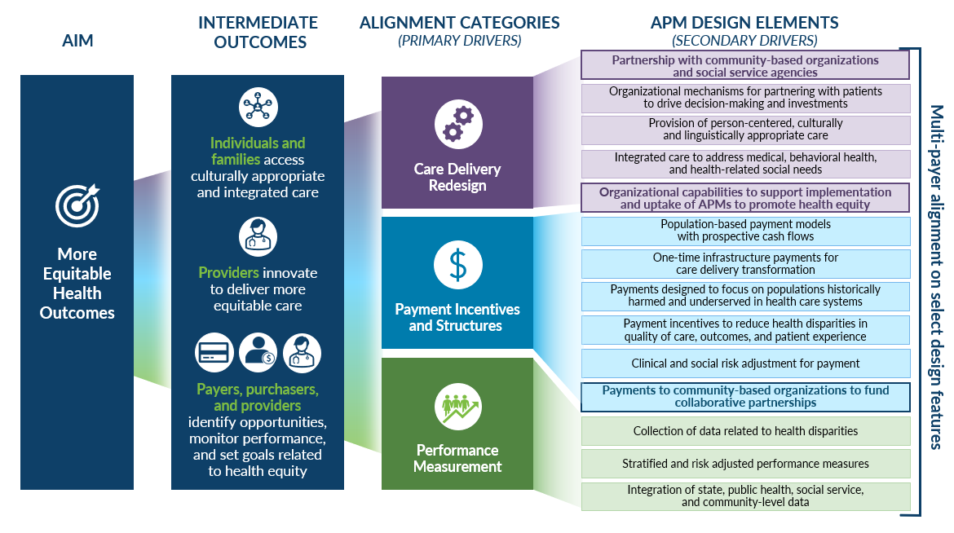
HEAT 2023 focus
The HEAT has developed a theory of change centered on how APMs advance Health Equity. A key driver of change—and the focus area of the HEAT for this year—is partnership with community-based organizations providing local health-related social needs services.

Slide 11
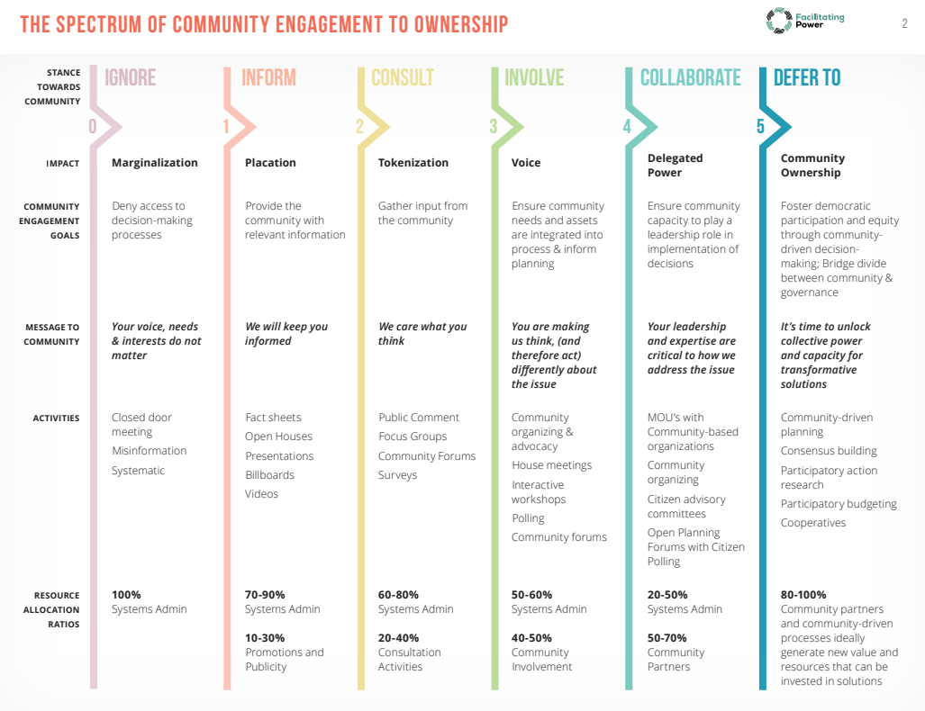
The Spectrum of Community Engagement to Ownership
Gonzalez R. The Spectrum of Community Engagement to Ownership. Movement Strategy Center. 2019.https://movementstrategy.org/resources/the-spectrum-of-community-engagement-to-ownership/
Notes:
Historical Context:
Trust is ultimately informed by actions and there are historical reasons for distrust in the healthcare sphere
Money, systems of privilege and oppression (racism, classism) institutional power imbalances in our healthcare system, are large reasons for historical power imbalances
CBOs are diverse organizations with complex histories working across different sectors with variable funding streams
Organizational Trust, Transparency, and Accountability
Trust is undermined when different terminology is used between health systems and human services
The vision we want to achieve with community partnership and payment reform needs to be built together with CBOs to foster organizational trust and buy-in
There needs to be accountability and room for local ownership
Payment Policy
Payment policy has an opportunity to impact trust publicly or negatively; money flow is inherent to power dynamics
There is a need to illustrate how financial transactions have enabled local learning and broad/sustained engagement
CBO models vary by program and funding stream; it is necessary to understand nuance

Slide 12
Guiding Principles to Elevate Individuals and Communities
Foundational principles to building trust and sharing power with the community:
Understand and respect lived experiences
Recognize the plurality of lived experiences
Respect the agency of individuals and communities
Engage the community early and often
Shift from “power over” to “power with”
Build on existing community assets

Slide 13
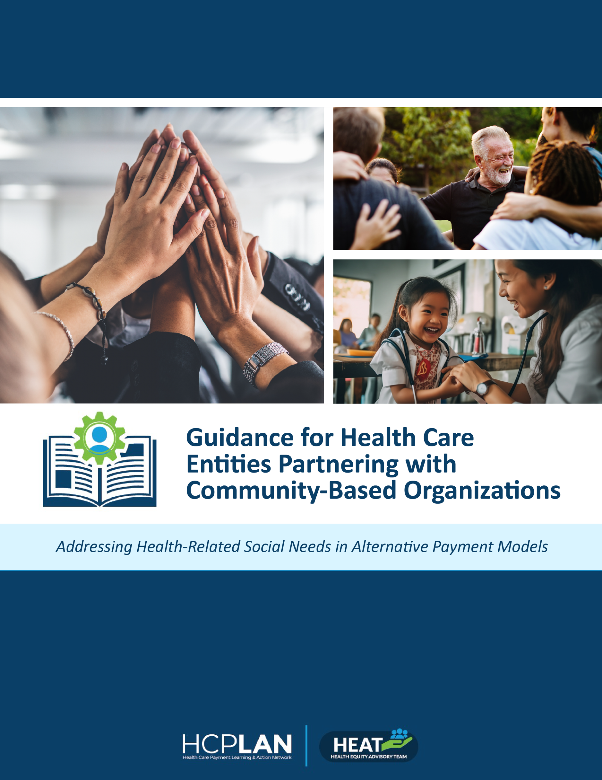
HEAT 2023 Guidance Document
This guidance document provides recommendations and examples of health policy and payment mechanisms utilized to address health-related social needs (HRSNs) with a focus on collaboration between community-based organizations (CBOs) and health care entities involved in alternative payment model (APM) design and delivery
The HEAT conducted interviews and focus groups with CBOs, community care hubs, and subject matter experts to glean insights into best practices and opportunities for improvement
https://hcp-lan.org/workproducts/APM-Guidance/HEAT-CBO-Partnership-Guidance.pdf
Notes:
Methodology
Representatives from 11 CBOs and community care hubs participated in semi-structured qualitative interviews, and three additional representatives participated in a semi-structured panel discussion.
Interviews and panel discussions took place from May-September 2023 with the goal of better understanding CBO and hub priorities, challenges experienced in partnering with health care entities, lessons learned, promising approaches, and how they ensure the community voice is represented.
The document is broken down into four key themes
Collaborative Governance Grounded in Mutual Respect and Shared Decision-Making Hubs and Neutral Conveners as Potential Conduits for Partnership
Hubs and Neutral Conveners as Potential Conduits for Partnership
Building CBO Capacity and Infrastructure through Multi-Sector Partnership
Funding and Financing to Support Cross-Sectoral Collaboration to Address Social Needs
Based on the Research there are many opportunities for multi-sector collaboration in advancing health equity.
Broader research and discussion regarding the need for the development of performance standards and quality metrics to standardize accountability for collaborative partnerships between health care entities and CBOs.
Quality or accountability measures to be used for CBOs partnering with health care entities.
When authentic multi-sector partnerships are realized, there is significant potential to accelerate progress in the health equity space and build sustainable and enduring engagement in the years to come.

Slide 14
CBO Interview Findings
The following themes emerged from our interviews and guided the development of recommendations:
Theme 1 Collaboration and Partnership: Building collaboration and equal partnership between Health Plans and CBOs is important to ensuring marginalized populations (often represented by CBOs) have a role in decision making and governance.
Theme 2 Hubs and Conveners: Hubs can offer broader networks of administrative and technical support to lessen burden on under-resourced and under-staffed CBOs in addition to balancing power dynamics between CBOs and larger entities.
Interview Themes
Theme 3 Infrastructure: CBOs are often in need of additional staff, care coordinators, financing, workflows to handle referrals, technical assistance, and technology platforms with data transparency.
Theme 4 Funding: Funding mechanisms are seldom developed with input from social needs service providers like CBOs or from community members. As a result, sometimes the available resources and payment rates for CBOs do not reflect the true costs of addressing social needs or providing the services desired by the community.

Slide 15
Collaborative Governance Grounded in Mutual Respect & Shared Decision-Making
Health care entities, with equal support from CBOs, consumer advocates, and community members—should collaborate to appoint an organizing body (e.g., a taskforce) that is rooted in the community to serve as a conduit for multi-directional engagement.
Health care entities should develop processes (e.g., advisory groups) for formalized decision-making that incorporate the voices of community members at all stages of programming, from conceptualization to implementation and evaluation.
Health plans should ensure that individuals hired for leadership positions (e.g., chief health equity officers) have previous experience working with CBOs.
Theme 1

Slide 16
Hubs and Neutral Conveners as Potential Conduits for Partnership
Health care entities should consider partnering with an organization that takes on the role of an aggregator, convenor, or facilitator for a network of CBOs that authentically represents the diverse communities the CBOs serve.
Health care entities should involve and compensate CBOs, convening organizations, consumer advocates, and community members in the co-design and implementation of APMs.
Health care entities should gain buy-in from CBO conveners (including hubs), by collaborating with them on community events that increase visibility and brand recognition.
Guidance

Slide 17
Building CBO Capacity and Infrastructure through Multi-Sector Partnership
Health care entities should offer technical assistance (TA) and resources for CBOs to develop the infrastructure needed to participate in APMs. Hubs, conveners, and larger CBOs play a critical role in providing TA and resources for CBOs and can offer these services at different levels depending on the existing capabilities of an individual CBO.
Health care entities should provide CBOs and conveners with technology and access to relevant data (including social needs data), and support CBOs in utilizing data effectively for baseline and longitudinal performance measures.
Health care entities should provide upfront funding to support technical assistance and resources.
Theme 3

Slide 18
Funding and Financing to Support Cross-Sectoral Collaboration to Address Social Needs
Payers and health plans should advocate for and help organize CBOs, CBO conveners, consumer advocates, and community members to influence state Medicaid waiver development
Health care entities should provide pre-funding support or infrastructure grants to help CBOs meet the necessary startup and operational needs to partner with the health system on providing social needs services
Payers and health plans should incorporate feedback from local health care purchasers and CBOs when developing plans for how to price and define CBO and CBO convener services in their state within existing in-lieu-of service (ILOS) authority.
Health care entities involved in value-based programs should require portions of bonuses, budgets, or budget surpluses be spent on social needs services or equity, in collaboration with the community and CBOs.
Theme 4

Slide 19
Questions?

