Slide 1


CEP Work Group
Clinical Episode Payment (CEP)
19 Members
Chair
Lewis Sandy, MD, MBA
Senior Vice President, Clinical Advancement, UnitedHealth Group
The group will identify the most important elements of clinical episode payment models for which alignment across public and private payers could accelerate the adoption of these models nationally. The emphasis will be on identification of best practices to provide guidance to organizations implementing clinical episode payment models.
Key Activities
Identifying the elements for elective joint replacement, maternity, and cardiac care episode payments
Identifying best practices for implementing clinical episode payment models
Notes:
The CEP Work Group identified the most important elements of clinical episode payment models for which alignment across public and private payers could accelerate the adoption of these models nationally, specifically for elective joint replacement, maternity, and cardiac care episode payments.

Slide 2

CEP Members
Member Roster
Lewis Sandy, MD, MBA
Executive Vice President, Clinical Advancement, UnitedHealth Group
Brooks Daverman, MPP
Director of the Strategic Planning and Innovation Group, Tennessee Division of Health Care Finance and Administration
François de Brantes, MS, MBA
Executive Director, Health Care Incentives Improvement Institute, Inc.
Mark Froimson, MD, MBA
Executive Vice President and Chief Clinical Officer Trinity Health, Inc.
Rob Lazerow
Practice Manager, Research and Insights
The Advisory Board Company
Catherine MacLean, MD, PhD
Chief Value Medical Officer, Hospital for Special Surgery
Jennifer Malin, MD, PhD
Staff Vice President, Clinical Strategy, Anthem, Inc.
Cara Osborne MSN, CNM, ScD
Chief Clinical Officer, Baby+Co.
Dale Paton Reisner, MD
Maternal Fetal Medicine Specialist
Swedish Medical Center
Carol Sakala, PhD, MSPH
Director of Childbirth Connection Programs
National Partnership for Women & Families
Richard Shonk, MD, PhD
Chief Medical Officer, the Health Collaborative
Steve Spaulding
Senior Vice President, Enterprise Networks
Arkansas BlueCross BlueShield
Barbara Wachsman
Chair, Pacific Business Group on Health
Jason Wasfy, MD
Director, Mass General Heart Center
Amy Bassano, MPP
Director, Patient Care Models Group, Centers for Medicare and Medicaid Services
Edward Bassin, PhD
Chief Analytics Officer, Archway Health
John Bertko, FSA, MAAA
Chief Actuary, Covered California
Kevin Bozic, MD
Chair of Surgery and Perioperative Care, Dell Medical School at the University of Texas at Austin
Alexandra Clyde, MS
Corporate Vice President of Global Health Policy, Reimbursement and Health Economics, Medtronic, Inc
Notes:
The CEP Work Group was chaired by Lewis Sandy (Executive Vice President, Clinical Advancement, UnitedHealth Group), and had 14 public and private members. This Work Group launched in December 2015 and has sunsetted.

Slide 3
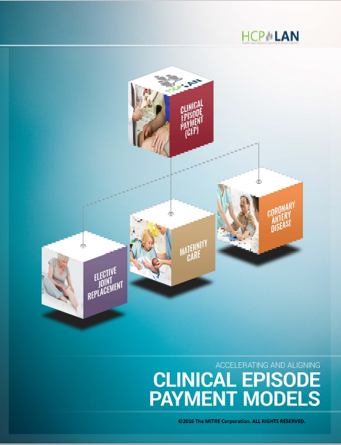
Accelerating and Aligning
for CEP models
The white paper titled Accelerating and Aligning Clinical Episode Payment Models provides high-level recommendations for designing clinical episode payment models. A clinical episode payment is a bundled payment for a set of services that occur over time and across settings. The paper outlines design elements and operational considerations for three selected clinical areas: elective joint replacement, maternity care, and coronary artery disease. Recommendations are organized according to design elements and operational considerations. Design elements address questions stakeholders must consider when designing an episode payment model, including the definition, the duration of the episode, what services are to be included, and others. Operational considerations relate to implementing an episode payment model, including the roles and perspectives of stakeholders, data infrastructure issues, and the regulatory environment in which APMs must operate. The recommendations are designed to speak to a multi-stakeholder audience with the goal of supporting broad clinical episode payment adoption.
Development
December 2015 –
February 2016
Draft Release
February 26, 2016
Public Comment
February 26 –
March 28, 2016
Revise
March 28 – July 25, 2016
Final Release
August 1, 2016
Notes:
The white paper titled Accelerating and Aligning Clinical Episode Payment Models provides high-level recommendations for designing clinical episode payment models. A clinical episode payment is a bundled payment for a set of services that occur over time and across settings. The paper outlines design elements and operational considerations for three selected clinical areas: elective joint replacement, maternity care, and coronary artery disease. Recommendations are organized according to design elements and operational considerations. Design elements address questions stakeholders must consider when designing an episode payment model, including the definition, the duration of the episode, what services are to be included, and others. Operational considerations relate to implementing an episode payment model, including the roles and perspectives of stakeholders, data infrastructure issues, and the regulatory environment in which APMs must operate. The recommendations are designed to speak to a multi-stakeholder audience with the goal of supporting broad clinical episode payment adoption.

Slide 4
Episode Selection Criteria
$
☑
Empowering Consumers
Conditions and procedures with opportunities to engage patients and family caregivers through the use of decision aids support for shared decision-making; goal setting and support for identifying high-value providers.
High Volume,
High Cost
Conditions and procedures for which high cost is due to non-clinical factors such as inappropriate service utilization and poor care coordination that correlate with avoidable complications, hospital readmissions, and poor patient outcomes.
Unexplained Variation
Conditions and procedures for which there is high variation in the care that patients receive, despite the existence evidence based “best” practices.
Care
Trajectory
Conditions and procedures for which there is a well-established care trajectory, which would facilitate defining the episode start, length, and bundle of services to be included.
Availability of Quality Measures
Conditions and procedures with availability of performance measures that providers must meet in order to share savings, which will eliminate the potential to incentivize reductions in appropriate levels of care.
Notes:
The CEP Work Group used this criteria to prioritize diseases and conditions on which their work would focus.
Empowering Consumers – identifies areas with shared decision-making, goal setting, and support
High Volume, High Cost – high cost is due to non-clinical factors
Unexplained Variation – high variation in care patients receive
Care Trajectory – well-established, which has a defined timeline for care and services
Availability of Quality Measures – performance measurements eliminate the potential to incentivize reductions in appropriate levels of care
Based on these considerations, the CEP Work Group agreed to focus on the following three priority areas:
Elective joint replacement;
Cardiac care; and
Maternity care.
The CEP Work Group believes that these priority areas have the greatest potential to create greater consensus and alignment of payment methods across payers and, thus, over time, to accelerate the adoption of clinical episode-based payments.

Slide 5

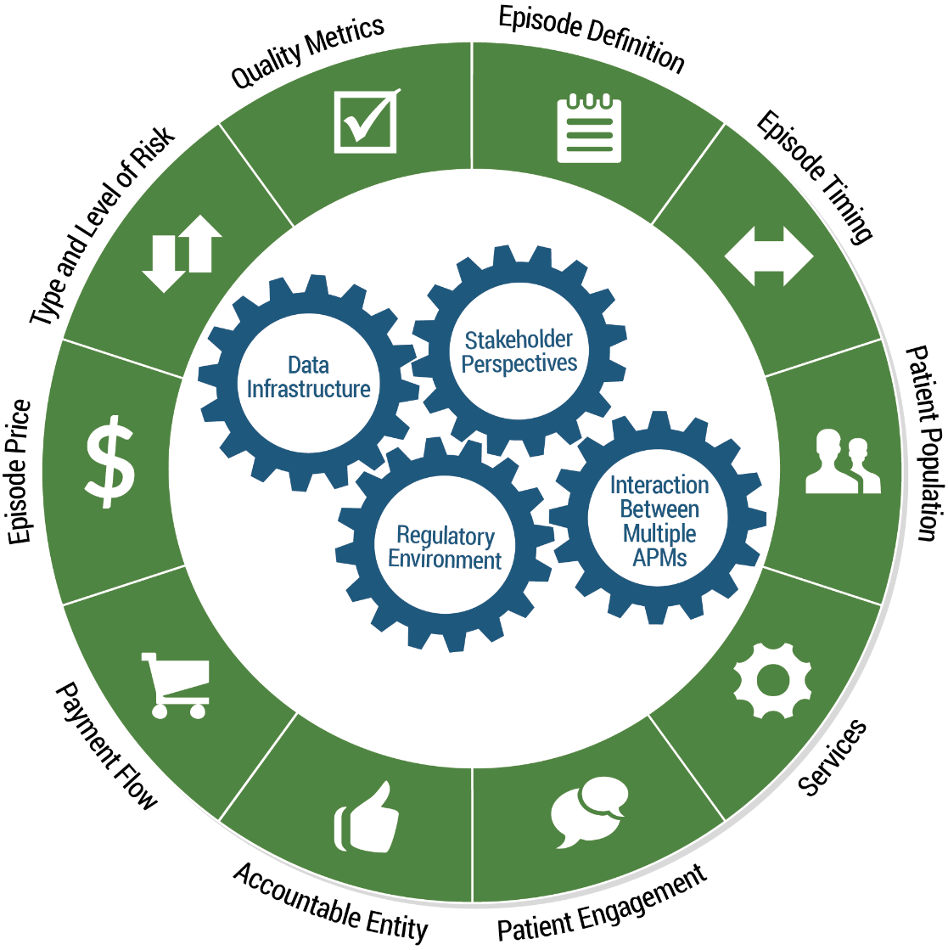
Episode Parameters
Episode Design and Operational Considerations
  Stakeholder Perspectives:
  Ensure that the voices of all stakeholders – consumers, patients, providers, payers, states and purchasers – are heard in the design and operation of episode payments
  Data Infrastructure:
  Understand and develop the systems that are needed to successfully operationalize episode payments
  Regulatory Environment:
  Recognize and understand relevant state and/or federal regulations, and understand how they support or potentially impede episode payment implementation
  Interaction between multiple APMs:
  Recognize questions and issues that may arise when determining how to implement episode payment together with other alternative payment models, such as population-based payment
Notes:
The Work Group’s recommendations fall into two categories:
Design Elements (in the green circle) address all of the questions stakeholders must consider when designing an episode payment model, including the definition, the duration of the episode, what services are to be included, and others
Operational Considerations (in the blue circles and called out on the right) are broader issues related to implementing an episode payment model, including the roles and perspectives of stakeholders, data infrastructure issues, and the regulatory environment in which APMs must operate. Operational considerations should not be assessed in a vacuum since they are inter-related to design element decisions.

Slide 6
Clinical Episode Timing
Generic Timeline for Episode Payments
Starting Point
Prior to date of intervention
Shared Decision Making
functional status tools &
decision aids
Stopping Point
Timeframe following date of intervention
Pre-Procedure
Event
Post-Procedure
Track Quality Measures
Episode Duration
30 days*
2-5 days*
90+ days*
* Varies based on episode. For illustrative purposes only

Slide 7

Retrospective
Steps | Role | Process
 | Health Plans/ Payers
 | Providers
 | Providers
 | Health Plans/ Payers & Providers
❶
Distributes Payment
(based on fee schedule)
Conduct Episode
❷
Pre-Procedure
Event
Post-Procedure
Pay Providers
Provider #1
Orthopedist
Provider #2
Hospital
Provider #3
Rehabilitation Center
2
5
8
❸
1
Total Cost of
Services Reconciled
(across population of episodes)
Reconcile Payments
7
10
3
4
6
9
Distribute Savings/Cost
(based on negotiated agreement)
❹
Distribute Savings/Overages
Notes:
Graphic #2: Retrospective Reconciliation
Here are the basic steps, and some context, for representing retrospective reconciliation. The example in the last bullet comes from the Arkansas Families First website (https://arfamiliesfirst.com/what-is-retrospective-reconciliation/) so we may need to cite that.
The payer initially distributes payment to each provider according to an established fee schedule.
After the episode, the total cost of services is reconciled against a clinically fair episode price.
Based on the negotiated agreement between payer and providers, savings or excess cost, relative to the episode price are divided among the payer and the accountable provider team.
The use of allotted funds will be assessed in groups of patients, not individual patients. For instance, if a provider had 10 ADHD clients and each one was allotted $3,000 for the 12-month episode, then the provider could bill up to $30,000 for that group of clients. One client may use over his $3,000, but another client may use less. The retrospective reimbursement will take the entire group into account and will not be based on individuals. This should help take out the incentive to refer on more serious clients to another provider.

Slide 8
Prospective
Steps | Role | Process
 | Health Plans/ Payers
 | Providers
 | Providers
 | Providers
❶
Single Upfront Payment
(for entire episode)
Conduct Episode
❷
Distribute Payment
Pre-Procedure
Event
Post-Procedure
Pay Provider
Provider #1
Orthopedist
Provider #2
Hospital
Provider #3
Rehabilitation Center
❸
Total Cost of
Services Reconciled
(across the health system)
Reconcile Payments
❹
Manage Savings/Cost
(upside/downside risk)
Manage Savings/Overages
Notes:
Prospective payment:
Payer provides a single upfront payment for the entire episode including all services and providers covered in the episode.
It is then up to the provider to whom the payment is made to determine how all the providers are paid underneath the single payment.
This type of payment is most appropriate when the provider entity has pre-established relationships with providers across the continuum of care, such as a health system.
If actual costs are lower than the prospective payment, on average across the population eligible for the episode, then the health system keeps the difference. If actual costs are higher, on average, then the health system is at risk for the amount above. Depending on the level and type of risk, the provider will negotiate limits on the amount they might have to absorb.

Slide 9
Retrospective vs. Prospective
 | Retrospective Reconciliation |  | Prospective Payment
Steps | Role | Process | Role | Process
 | Health Plans/Payers | Distributes Payment (based on fee schedule) | Health Plans/ Payers | Single Upfront Payment (for entire episode)
 | Providers |  | Providers | Payment Distributed (across health system)
 | Providers | Total Cost of Services Reconciled (across population of episodes) | Providers | Total Cost of Services Reconciled (across health system)
 | Health Plans/ Payers & Providers | Distribute Savings/Cost (based on negotiated agreement) | Providers | Manage Savings/Cost (upside/downside risk)
❶
Conduct Episode
Pay Provider
❷
Reconcile Payments
❸
Manage Savings/Overages
❹
Notes:
As shown on this slide, there are two ways to design and administer a bundled payment.

Slide 10


Elective Joint Replacement
Elective hip and knee replacement for CEP models
The white paper titled Accelerating and Aligning Clinical Episode Payment Models provides high-level recommendations for designing clinical episode payment models. A clinical episode payment is a bundled payment for a set of services that occur over time and across settings. The paper outlines design elements and operational considerations for three selected clinical areas: elective joint replacement, maternity care, and coronary artery disease.
The elective joint replacement recommendations emphasize using functional status assessments (both pre- and post-procedure) and shared decision-making tools to determine whether a joint replacement is the appropriate treatment for a given patient. The recommendations are designed to speak to a multi-stakeholder audience with the goal of supporting broad clinical episode payment adoption.
Development
December 2015 –
February 2016
Draft Release
February 26, 2016
Public Comment
February 26 –
March 28, 2016
Revise
March 28 – July 25, 2016
Final Release
August 1, 2016
Notes:
The white paper titled Accelerating and Aligning Clinical Episode Payment Models provides high-level recommendations for designing clinical episode payment models. A clinical episode payment is a bundled payment for a set of services that occur over time and across settings. The paper outlines design elements and operational considerations for three selected clinical areas: elective joint replacement, maternity care, and coronary artery disease.
The elective joint replacement recommendations emphasize using functional status assessments (both pre- and post-procedure) and shared decision-making tools to determine whether a joint replacement is the appropriate treatment for a given patient. The recommendations are designed to speak to a multi-stakeholder audience with the goal of supporting broad clinical episode payment adoption.

Slide 11
Elective Joint Replacement –
Design Elements
Summary of Elective Joint Replacement Episode Recommendations
Design Elements
1. Episode Definition | 2. Episode Timing | 3. Patient Population | 4. Services | 5. Patient Engagement
Elective & appropriate total hip and total knee replacement due to osteoarthritis | Start pre-procedure and end 90 d. post-discharge, and meet requirements | Broadest-possible pool of patients with risk/severity adjusted | All services needed by the patient related to the joint replacement procedure | Patient engagement tools and supports should be available at all stages of care, including transparent cost & care info
6. Accountable Entity | 7. Payment Flow | 8. Episode Price | 9. Type and Level of Risk | 10. Quality Metrics
Provider best able to engineer change in the way care is delivered to the patient, and able to accept risk. The orthopedic surgeon may fit this role, as may other clinicians | Payment flow –either retrospective reconciliation or prospective payment – depends on unique characteristics of the models’ players. However, prospective payment is recommended for TJR | Balance single and multiple providers, and regional utilization history. Reflect the cost of services needed to achieve the goals of the episode payment model | Upside reward and/or downside risk, depending on the model | Clinical and Patient-Reported Outcome measures; use of quality measurement for payment and accountability
Notes:
CEP Work Group members conducted research and analysis on a range of existing episode payment initiatives. Based on their experience and the analysis of current initiatives, the Work Group identified a set of episode payment model design elements. These elements reflect the decisions that payers and providers need to make before implementation.

Slide 12
Elective Joint Replacement - Timeline
Episode Timeline for Elective Joint Replacement
Determination of Appropriateness of Elective Procedure “triggers” starting point
Starting Point
Pre-procedure, with enough time for diagnostics and pre-conditioning
Stopping Point
90 days post-discharge
Pre-operative Surgical Visit
Pre-operative Preparation & Planning
Preparation, Operation and PACU
Inpatient Stay & Discharge Process
Post-discharge Rehabilitation & Follow-up Care
Track Quality Measures
Episode Duration
~ 30 for example
~ 6 hours
~ 3 days
12 months
Shared Decision Making to determine appropriateness of procedure, and throughout the episode.
Source: Derived from Premier, Inc., and Institute for Healthcare Improvement. Integrated Care Pathway for Total Joint Arthroplasty. Charlotte, NC: Premier, Inc. and Cambridge, MA: Institute for Healthcare Improvement; 2013. (Available at www.premierinc.com and www.ihi.org)
Notes:
This slide shows the Timeline of Episode Duration, with Care Pathway Overlay as recommended by the CEP Work Group for the joint bundle.

Slide 13


Maternity Care
for CEP models
The white paper titled Accelerating and Aligning Clinical Episode Payment Models provides high-level recommendations for designing clinical episode payment models. A clinical episode payment is a bundled payment for a set of services that occur over time and across settings. The paper outlines design elements and operational considerations for three selected clinical areas: elective joint replacement, maternity care, and coronary artery disease.
The maternity care recommendations outlined in this chapter emphasize the need for patient engagement, education, and parenting support services (in addition to clinical maternity care), to achieve a number of critical goals. These include increasing the percentage of full-term births and the percentage of vaginal births, while decreasing the percentage of pre-term and early elective births, complications, and mortality. They are designed to speak to a multi-stakeholder audience with the goal of supporting broad clinical episode payment adoption.
Development
February – April 2016
Draft Release
April 22, 2016
Public Comment
April 22 – May 23, 2016
Revise
May 23 – July 25, 2016
Final Release
August 1, 2016
Notes:
The white paper titled Accelerating and Aligning Clinical Episode Payment Models provides high-level recommendations for designing clinical episode payment models. A clinical episode payment is a bundled payment for a set of services that occur over time and across settings. The paper outlines design elements and operational considerations for three selected clinical areas: elective joint replacement, maternity care, and coronary artery disease.
The maternity care recommendations outlined in this chapter emphasize the need for patient engagement, education, and parenting support services (in addition to clinical maternity care), to achieve a number of critical goals. These include increasing the percentage of full-term births and the percentage of vaginal births, while decreasing the percentage of pre-term and early elective births, complications, and mortality. They are designed to speak to a multi-stakeholder audience with the goal of supporting broad clinical episode payment adoption.

Slide 14
Maternity Care – Design Elements
Summary of Maternity Care Episode Recommendations
Design Elements
1. Episode Definition | 2. Episode Timing | 3. Patient Population | 4. Services | 5. Patient Engagement
Episode includes maternity and newborn care for the majority of pregnancies that are lower risk, as well as for women with elevated risk conditions for which there are defined and predictable care trajectories. | Episode begins 40 weeks before the birth and ends 60 days postpartum for the woman, and 30 days post-birth for the baby. | The population is women and newborns who are lower-risk, as well as women who may be at elevated risk due to conditions with defined and predictable care trajectories. | All services provided during pregnancy, labor and birth, and the postpartum period (for women); and newborn care for the baby. Pediatric services are not included. Other service exclusions should be limited. | Engage women and their families in all three phases of the episode (prenatal, labor and birth, and postpartum/newborn).
6. Accountable Entity | 7. Payment Flow | 8. Episode Price | 9. Type and Level of Risk | 10. Quality Metrics
Accountable entity chosen based on readiness to both re-engineer change in the way care is delivered to the patient, and to accept risk. Shared accountability may be required, given that a patient may be cared for by multiple practitioners across multiple settings. | Payment flow – either retrospective reconciliation or prospective payment – depends on the unique characteristics of the model’s players. | The episode price should balance single and multiple providers and regional utilization history. It should reflect the cost of services needed to achieve the goals of the episode payment model. | Ultimate goal is both upside reward and downside risk, with strategies in place to mitigate risk, encourage provider participation, and support inclusion of a broad patient population.. | Prioritize use of metrics that support the episode goals, including measures of clinical outcomes and patient reported outcomes, for use in payment, accountability, quality scorecards, and other tools to communicate with and engage patients and other stakeholders.
Notes:
CEP Work Group members conducted research and analysis on a range of existing episode payment initiatives. Based on their experience and the analysis of current initiatives, the Work Group identified a set of episode payment model design elements. These elements reflect the decisions that payers and providers need to make before implementation.

Slide 15
Maternity Care – Timeline
Episode Timeline for Prenatal through Postpartum Care
Goals
Use of evidence-based care to achieve woman- and family-centered care
  Improving coordination across providers, settings, and maternity care
Starting Point
~ 40 weeks prior or pregnancy
Birth
Post 37 weeks for low-risk pregnancies
Stopping Point
~ 60 days post-birth
Prenatal
Labor & Birth
Postpartum
Track Quality Measures
Episode Duration
~ 40 weeks
~ 2-10 days
~ 60 days (mother)
~ 30 days (baby)
Reimbursable Services
Labor and Birth
Breastfeeding support
Depression screening
Contraception planning
Ensuring link from
birth to pediatric care provider occurs
Increase:
 % of full-term births
 % of vaginal births
Decrease:
➲ % of pre-term and elective births
➲ % of C-sections
➲ Complications and mortality (inc. readmission & levels of NICU use)
Directly Related | Not Typically Reimbursed | NOT Directly Related
Monthly prenatal visits Routine ultrasound Blood testing Diabetes testing Genetic testing | Doulas Care coordinators Group education meetings Childbirth education classes | Preventive screenings (chlamydia, cervical cancer)
Services
(Examples)
Notes:
Graphic #1: Timeline of Episode Duration, with Care Pathway Overlay
Chevrons depict the following
Episode start is 40 weeks prior to childbirth
Episode ends 60 days after birth
Show three phases: prenatal, labor and birth, and postpartum
In each of the three phases show activities/care that occurs.
Prenatal: Use of evidence-based care to achieve the following goals, all of which lead to woman- and family-centered care:
increase percentage of births that are full-term, and reduce preterm and early elective births,
increase percentage of vaginal births and decrease the rate of C-sections
Decrease complications and mortality, including readmissions and levels of NICU use
Engaging women and families in their maternity care
Improving coordination across providers, settings and maternity care
Labor and birth: Delivery post-37 weeks; vaginal delivery for Nulliparous Term Singleton Vertex (NTSV) (lowest risk) pregnancies
Postpartum: postpartum care support, including postpartum depression screening; contraception planning; ensuring link from birth to pediatric care provider occurs

Slide 16


Coronary Artery Disease
for CEP models
The white paper titled Accelerating and Aligning Clinical Episode Payment Models provides high-level recommendations for designing clinical episode payment models. A clinical episode payment is a bundled payment for a set of services that occur over time and across settings. The paper outlines design elements and operational considerations for three selected clinical areas: elective joint replacement, maternity care, and coronary artery disease.
Episode payment for CAD establishes a budget that incentivizes the providers managing the patient to more appropriately balance the needs of the patient and the number and type of services provided. Placing accountability for the entire condition with a designated provider also encourages the active management of the patient in order to prevent acute events that lead to worsening health, further procedures, and an increased risk of overall poor outcomes. The goal of person-centered episode payment is to make the patient the focus of care management, ensuring that any efficiencies achieved through improved care coordination and management first and foremost benefit the patient.
Development
February – April 2016
Draft Release
May 20, 2016
Public Comment
May 20 – June 20, 2016
Revise
June 20 – July 25, 2016
Final Release
August 1, 2016
Notes:
The white paper titled Accelerating and Aligning Clinical Episode Payment Models provides high-level recommendations for designing clinical episode payment models. A clinical episode payment is a bundled payment for a set of services that occur over time and across settings. The paper outlines design elements and operational considerations for three selected clinical areas: elective joint replacement, maternity care, and coronary artery disease.
Episode payment for CAD establishes a budget that incentivizes the providers managing the patient to more appropriately balance the needs of the patient and the number and type of services provided. Placing accountability for the entire condition with a designated provider also encourages the active management of the patient in order to prevent acute events that lead to worsening health, further procedures, and an increased risk of overall poor outcomes. The goal of person-centered episode payment is to make the patient the focus of care management, ensuring that any efficiencies achieved through improved care coordination and management first and foremost benefit the patient.

Slide 17
Coronary Artery Disease –
Episode Design
Summary of Coronary Artery Disease Episode Recommendations
Design Elements
1. Episode Definition | 2. Episode Timing | 3. Patient Population | 4. Services | 5. Patient Engagement
Condition: 12 months of active CAD management Procedure: PCI or CABG for treatment of CAD | Condition: Parallel to benefit year Procedure: Pre-op, procedure, and 30-90 days post-discharge | Condition: Patients diagnosed with CAD and in same health plan for full 12 months Procedure: Patients deemed to need a PCI or CABG based on appropriate use guidelines | Both: Core services for CAD management and for quality delivery of procedure. | Both: Patient education and self-management tools, patient and family engagement in care planning and care transitions; shared decision-making
6. Accountable Entity | 7. Payment Flow | 8. Episode Price | 9. Type and Level of Risk | 10. Quality Metrics
Condition: Cardiologist and/or PCP accountable for condition and for overall episode Procedure: Intensivist or cardiothoracic surgeon | Both: Payment flow – either upfront FFS or prospective payment – depends on the unique characteristics of the model’s players. | Both: Balance regional/multi-provider and provider-specific utilization history; Acknowledge efficiencies; be feasible to attain | Both: Upside and/or downside risk, depending on the model. | Both: Clinical and patient-reported outcomes; including functional status Procedure: Process and outcome measures

Slide 18
Fragmentation Of Care
For Coronary Artery Disease
Primary
Care
Home
Health
Lack of
Appropriate
Follow-up Testing
Specialty Care
Diagnostic
Errors
In-patient &
Out-patient
Hospital
Hospice
Post-acute
Care
Hospital
Readmission
Adverse Drug
Events
Notes:
This graphic that conveys the fragmentation of cardiac care across the following settings:
Primary care
Specialty care
In-patient and out-patient hospital
Post-acute care (Skilled nursing facilities, rehab)
Home health
Hospice
and the results of that fragmentation:
adverse drug events
hospital readmissions
diagnostic errors
lack of appropriate follow-up testing

Slide 19
Coronary Artery Disease – Timeline
Episode Timing for Percutaneous Coronary Intervention (PCI) and Coronary Artery Bypass Graft (CABG)
Starting Point
Diagnosis by non-acute event
OR acute event
Stopping Point
~ 12 months
Active Management of
Coronary Artery Disease
Active Management of
Coronary Artery Disease
PCI/CABG
Services: Diagnostic, preventative care, medication management, care management, and lifestyle change support
Episode Duration
~ 12 month period (first episode may be shorter, depending on start point)
~ 12 month period
0
30
60
90
Pre-Operative
Procedure
Post Discharge
varies
varies
~ 30-90 days
Notes:
This slide shows the Work Group’s proposed Timeline of Episode Duration, with Care Pathway Overlay as recommended by the CEP Work Group for cardiac care.

Slide 20
Coronary Artery Disease –
Price & Care
Why a Nested Cardiac Care Episode?
Type of Care
Primary Care
Provider
or Cardiologist
CAD
Condition
Management
Active Management of
Coronary Artery Disease
Procedure is determined appropriate by Heart Team (Cardiologist, PCP, cardiothoracic surgeon, cardiac anesthesiologist, hospitalist) using data and Appropriate Use Criteria
PCI/
CABG
Inpatient &
Outpatient
Hospital
Nested Episode Design
Interventionalist (PCI) or Cardiothoracic Surgeon (CABG)
Incentive to coordinate care delivery since both parties are at risk financially
Make value-based decisions – using quality measures and historical costs – when partnering
Additional clinicians and settings involved in CAD Care: CCC Cath Lab, Cardiac Rehabilitation Facility, others.
Notes:
This infographic depicts the rationale for having a condition episode with a nested procedure episode:
The CAD condition is generally managed by a primary care provider and/or cardiologist.
The procedure is often conducted by an interventionalist (PCI) or a cardiothoracic surgeon (CABG).
By establishing an episode-based payment for the procedure, incentives are created for the PCP/Cardiologist to: 1) coordinate clinical care delivery with the interventionalist/cardiothoracic surgeon since they are both at financial risk if a patient requires a readmission or faces other negative outcomes; and 2) make value-based decisions – using quality measures and historical costs – when selecting interventionalists/surgeons with which to contract/partner.

